Slide 1
TITLE: Best Smartphones To Buy In 2022 Under 30k!
By Shrey Aswal

Slide 2
Reason for choosing this project
Reason: Highest level of competition in smartphones in this range in India.
Since the past few days I have been searching for a new smartphone to buy which would have amazing features and not cost me a lot of money.
I have referred to many youtube videos and figured out the best smartphones under different categories
which is why I have choosen this topic.

Slide 3
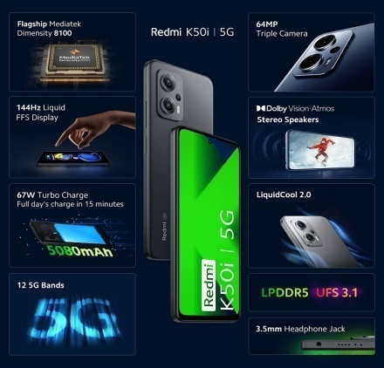
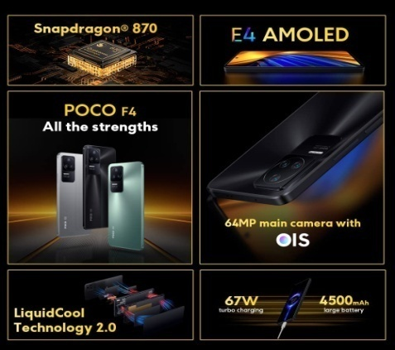
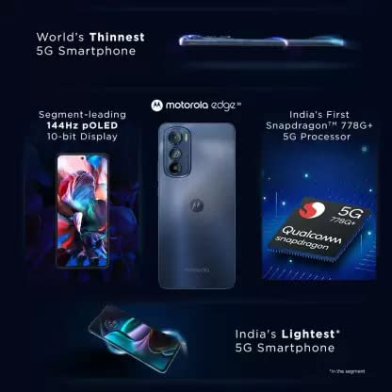

Wireframe Image & link
Wireframe link:
file:///C:/Users/world/Desktop/Website%20Blog/index.html

